Slide 1
GCSE
Practical programming skills in Python
Programming techniques
Topic 10
10

Slide 2
Objectives
Use programming ’set pieces’ for common problems
Use a ‘flag’
Use a while loop to validate data entry
Create a menu system

Slide 3
Starter Activity
Which of these lists are in ascending order?
listA = [12, 17, 42, 56, 68] listB = [21, 23, 39, 28, 42] listC = [-12, -3.7, 2.01, 2.23]

Slide 4
Starter Activity
Which of these lists are in ascending order?
listA = [12, 17, 42, 56, 68] √ listB = [21, 23, 39, 28, 42] X listC = [-12, -3.7, 2.01, 2.23] √

Slide 5
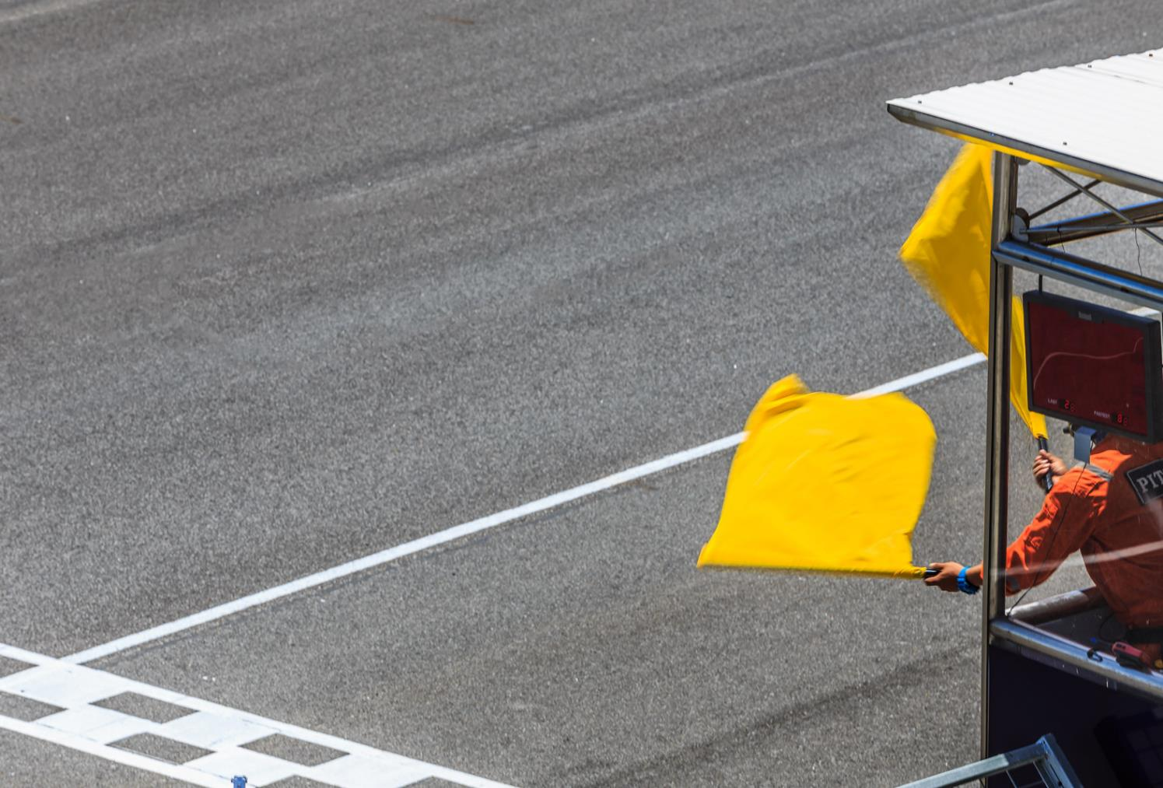
Flag
A ’flag’ is a variable that is used to check if something has happened
A flag is usually a binary, or Boolean value, e.g. True or False

Slide 6
Flag
This program will check if an answer is correct
The name of the flag in this example is “correct”
correct = False
answer = int(input("12 x 3? "))
if answer == 36:
correct = True

Slide 7
Flag
This flag can be checked later
if correct == True:
print("User was correct")
else:
print("User was wrong")

Slide 8
Worksheet 10a
Complete Questions 1, 2 and 3

Slide 9
The break statement
This program checks whether a list is sorted in ascending sequence
The break statement causes control to pass to the next statement after the for loop
myList = [12, 17, 42, 56, 68] for i in range(len(myList)-1):
if myList[i] < myList[i+1]:
print("OK so far")
else:
print("Wrong order")
break

Slide 10
Writing efficient code
Printing out the result for each step is inefficient
Can you rewrite the loop more efficiently?
myList = [12, 17, 42, 56, 68] for i in range(len(myList)-1):
if myList[i] < myList[i+1]:
print("OK so far")
else:
print("Wrong order")
break

Slide 11
Writing efficient code
Rewrite the if statement:
valid = True # assume list is valid myList = [12, 17, 42, 56, 68] for i in range(len(myList)-1):
if myList[i] > myList[i+1]:
print("Wrong order")
valid = False
break

Slide 12
Using a flag and a while loop
Using the break statement is not considered good practice.
Instead, you can use a flag and a while loop
valid = True # assume list is valid myList = [12, 17, 42, 56, 68]
i = 0
while valid == True and i < len(myList)-1: (complete the code to print either
"List is unsorted" or
"List is in ascending order")

Slide 13
Using a flag
valid = True # assume list is valid myList = [12, 17, 42, 56, 68]
i = 0
while valid == True and i < len(myList)-1: if myList[i] > myList[i+1]:
valid = False
print("List is unsorted")
else:
i = i + 1
if valid == True:
print("List is in ascending order")

Slide 14
Validation
Try the following code:
choice = "" while choice != "y" and choice != "n":
choice = input("Enter ‘y’ or ‘n’: ") if choice == "y" : print("You chose ‘yes’")
else: print("You chose ‘no’")

Slide 15
Validation
Validating an input means checking that the data you have collected is reasonable or possible:
Shoe shops generally sell shoes between sizes 1-13
Create a program that will:
ask the user for a shoe size
give an error if the number entered is invalid
allow the user to try again until they enter a valid number

Slide 16
Validation
Shoe size example:
size = 0 while size < 1 or size > 13:
size = int(input("Enter a shoe size \
between 1 and 13: "))
print("Accepted")

Slide 17
Validation
Alternative shoe size example:
size = int(input("Enter a shoe size:")) while size < 1 or size > 13:
size = int(input("Error, must be 1-13: "))
print("Accepted")

Slide 18
Validation
Common rules for validation:
set an empty value or ask for a value first
create a while loop that will repeat while the answer is invalid
ask for a value inside the loop as well

Slide 19
Worksheet 10b
Complete Worksheet 10b

Slide 20
Menu system
Many programs would benefit from a menu system
Using subroutines (functions and procedures) and validation together makes this really easy

Slide 21
Menu system
First, create some empty procedures:
def option1():
print("Option 1 run")
def option2():
print("Option 2 run")

Slide 22
Menu system
Second, print the menu and use a selection statement:
print("Main Menu") print("1. Option 1")
print("2. Option 2")
choice = int(input("Choose an option: ")
if choice == 1:
option1()
elif choice == 2:
option2()

Slide 23
Menu system
Third, add a validation loop:
print("Main Menu") print("1. Option 1")
print("2. Option 2")
choice = int(input("Choose an option: ")
while choice != 1 and choice != 2:
choice = int(input("Error, enter 1 or 2: "))
if choice == 1:
option1()
elif choice == 2:
option2()

Slide 24
Menu system
Alternative validation loop (useful for lots of options):
print("Main Menu") print("1. Option 1")
print("2. Option 2")
(print more options here)
choice = int(input("Choose an option: ")
while choice not in (1,2,3,4,5):
choice = int(input("Error, enter 1 - 5: "))
if choice == 1:
option1()
elif choice == 2:
option2()
etc.

Slide 25
Worksheet 10c
Complete Worksheet 10c

Slide 26
Plenary
Explain the meaning of these terms:
Flag
Validation

Slide 27
Plenary Answers
Explain the meaning of these terms:
Flag
A variable (usually a Boolean) is used to check whether something has happened
Validation
A method of checking data input in order to reject data that is obviously wrong

